Slide 1



Week 12
EXPLORATORY DATA ANALYSIS
https://intip.in/EDAIUP2022
Teaching Assistant :
Bramandika (06211940000059)
Maura Putri Defa (06211940000139)
Sepuluh Nopember Institute of Technology, Surabaya - Indonesia

Slide 2
LOESS Regression
‹#›
Notes:
https://www.youtube.com/watch?v=Vf7oJ6z2LCc

Slide 3
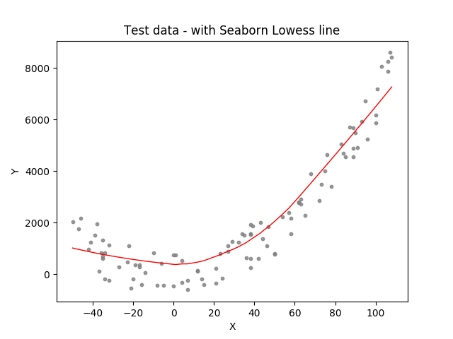
LOWESS (Locally Weighted Scatterplot Smoothing), sometimes called LOESS (locally weighted smoothing), is a popular tool used in regression analysis that creates a smooth line through a time plot or scatter plot to help you to see relationship between variables and foresee trends.

Slide 4
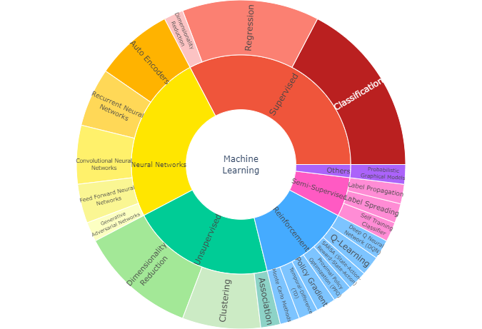
LOWESS sits within the family of regression algorithms under the umbrella of Supervised Learning. This means that you need a set of labeled data with a numerical target variable to train your model.
Notes:
https://towardsdatascience.com/lowess-regression-in-python-how-to-discover-clear-patterns-in-your-data-f26e523d7a35

Slide 5
What is Lowess Smoothing used for?
Fitting a line to a scatter plot or time plot where noisy data values, sparse data points or weak interrelationships interfere with your ability to see a line of best fit.
Linear regression where least squares fitting doesn’t create a line of good fit or is too labor-intensive to use.
Data exploration and analysis in the social sciences, particularly in elections and voting behavior.
‹#›

Slide 6
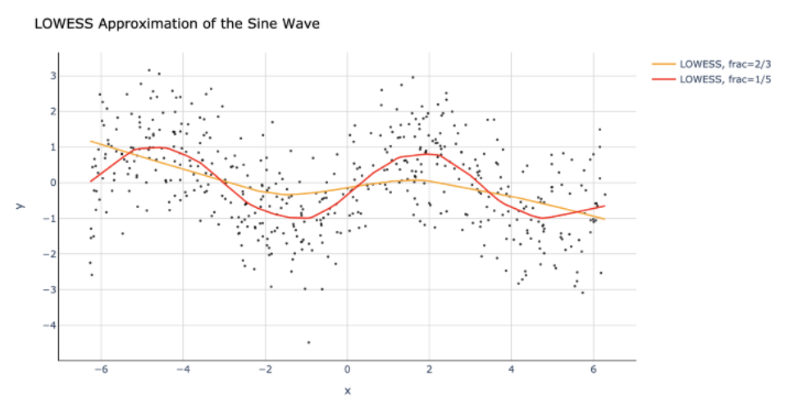
We will use an example to illustrate how LOWESS works. Let us start by creating a scatterplot where the data points follow a sine wave pattern, but they have some random noise added, making the pattern less obvious.
After that, we perform a LOWESS regression analysis a couple of times using different hyperparameters and add LOWESS curves to the plot:
‹#›

Slide 7
Benefits of Non-Parametric Smoothing
Provides a flexible approach to representing data.
Ease of use.
Computations are relatively easy.
Disadvantages of Non-Parametric Smoothing
Can’t be used to obtain a simple equation for a set of data.
Less well understood than parametric smoothers.
Requires the analyst to use a little guesswork to obtain a result.
‹#›
Exploratory Data Analysis 2021

Slide 8
Implementation
If you are sampling data generated from a physical phenomenon, you will get noise. Noise can be added to the signal by the sensor measuring it, or it can be inherent to the stochasticity of the process that generates the data.
Example we had to handle one such noisy data stream generated by a vehicle engine and needed to figure out a way to filter out the noise. Due to the physical nature of the signal generation process, the sampling frequency was not constant, thereby precluding any frequency-based noise filtering technique.
We needed to find a way to filter out the noise and recreate the signal for further processing.
‹#›
Notes:
https://towardsdatascience.com/loess-373d43b03564

Slide 9
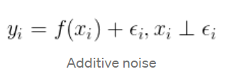
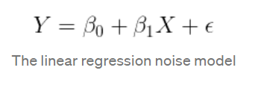
Implementation
In order to recover the signal from the measured noise, we must start by making a few assumptions about how the noise is generated. In statistical terms, this means that we must assume some distribution for the noise, a mathematical description of how it is generated.
The most common assumptions involve random noise that is generated according to a Gaussian distribution, an additive model where the noise is added to the signal, and an error term that is independent of x, like so:
‹#›
Notes:
https://towardsdatascience.com/loess-373d43b03564

Slide 10
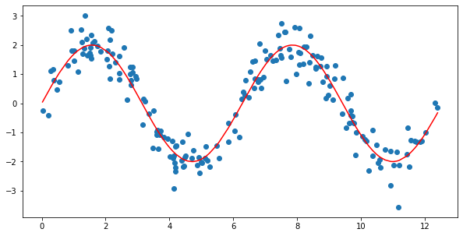
Implementation
So how does LOESS work? Let’s start with a noisy signal like the one below.
This is a synthetically generated sine wave with added Gaussian noise. The sine wave is drawn in red while the noisy samples are displayed as blue dots. To simulate an irregularly sampled signal, the x values were randomly sampled from a uniform distribution and scaled appropriately. The corresponding y values were calculated using a sine function with added Gaussian noise.
‹#›
Notes:
https://towardsdatascience.com/loess-373d43b03564

Slide 11
Implementation
So how do we get from the blue dots to an approximation of the red line? First of all, think of the red line as an ordered sequence of equally spaced x values, in this case between 0 and 2π.
For each of these values, select an appropriate neighborhood of sampled points, and use them as the training set for a linear regression problem. With the resulting model, estimate the new value for your point.
‹#›
Notes:
https://towardsdatascience.com/loess-373d43b03564

Slide 12
Thank you!

